Slide 1
ReThink ReFeed
Jayalakshmi Vaidyanathan
Ritika Mathur
Sarah Fernandes
Varuna Paul Jeeva

Slide 2
AGENDA
Business Need
About our Organization
Business Value
System Operations
User Interface
Conclusion

Slide 3
Problem
Food waste is one of the biggest problems in the world today
According to the U.N. Food and Agriculture Organization (FAO), at least 1.3 billion tons of food is lost or wasted every year globally—in fields, in storage, at restaurants, and in markets
The United States wastes about 62.5 million tons and spends $218 billion a year in “growing, processing, transporting, and disposal of food that is never eaten”
On the other hand, 1 in 7 people are hungry in the US. According to the United Nations, if we recover all the food that is lost or wasted, we will have enough to feed all those who are hungry, four times over

Slide 4
Challenge
Difficulty in matching organizations / individuals willing to donate and people in need of food
Very few organizations address this problem

Slide 5



Solution
Web-based ‘marketplace’ that will connect the organizations
Donors with excess food, post details online
The system will send alerts to all the charities and nonprofits in the system based on location and food preferences
Match is made, the food rescue volunteers who work with the organization will recover the surplus food and deliver it to the charities in need

Slide 6
Business value
Reduces waste
Feeds the hungry
Saves money
Reduces Inventory
Boosts morale
Helps the environment

Slide 7
Our System Operations
User account creation and management
Networking services
Real time updates and alerts about availability of food
Food Recovery and Delivery
Financial donation portal
Reporting system
Personnel management system
User Feedback system

Slide 8
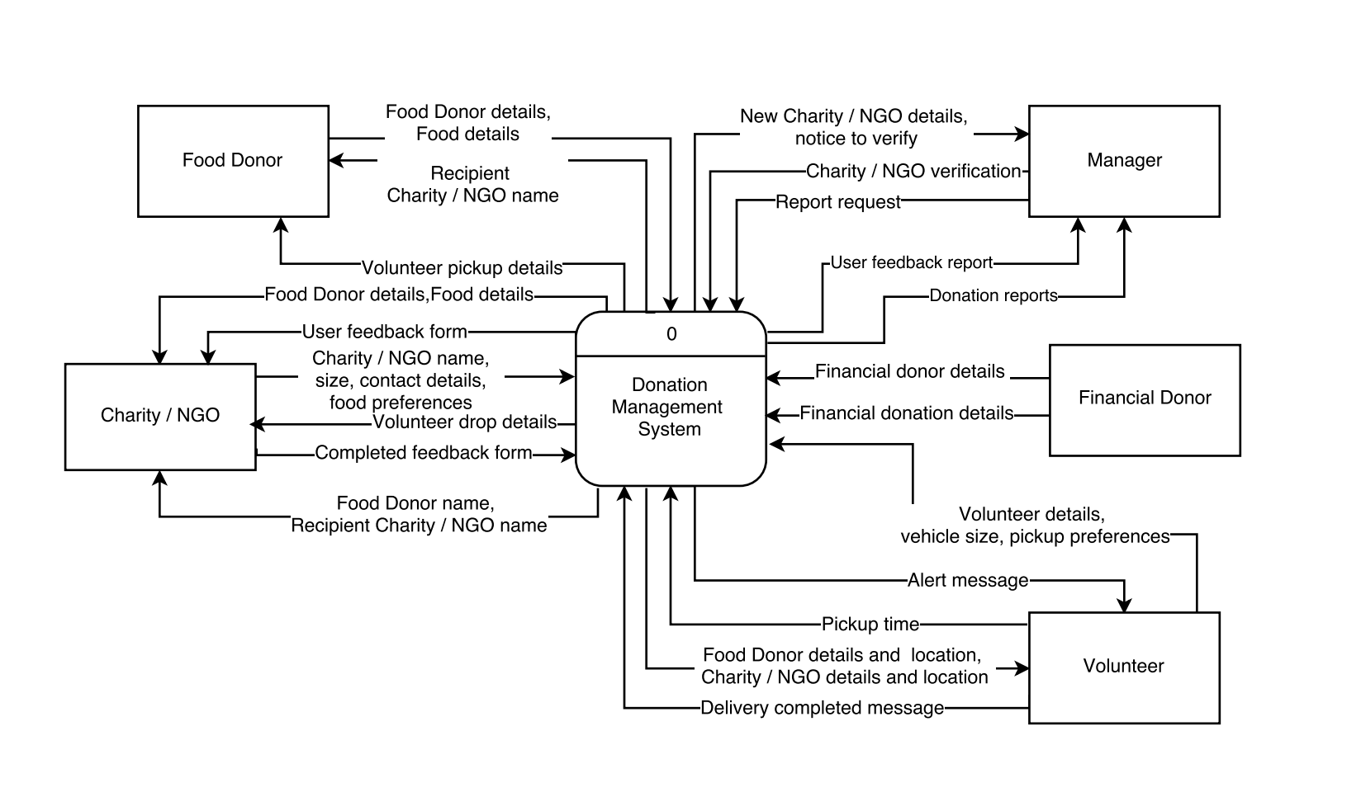
Context diagram

Slide 9
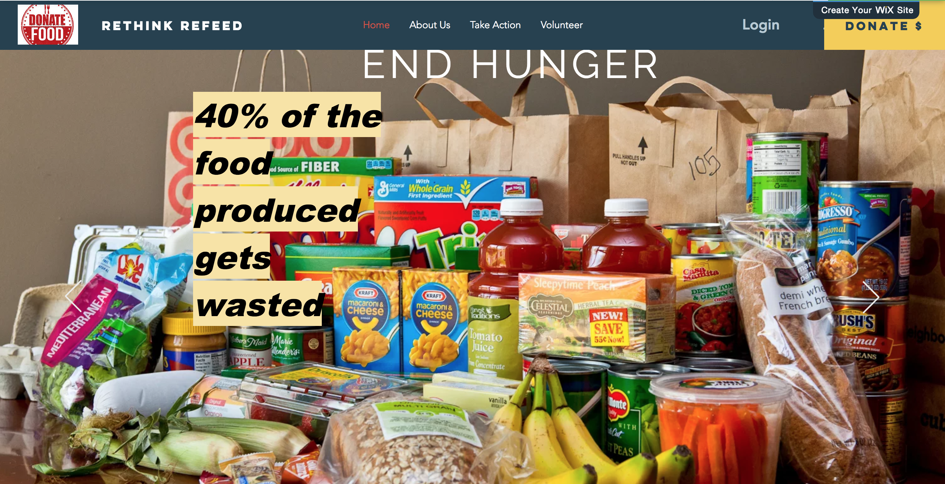
User Interface
https://editor.wix.com/html/editor/web/renderer/edit/88eb09c1-c111-41b7-97f4-7e9e0e080e84?metaSiteId=37489c82-8f39-
47d3-a30b-d7d93f2deee6&editorSessionId=8C85B37A-FA6D-4349-8712-46316A8757AC&referralInfo=my-account

Slide 10
Conclusion
Future Scope
Expand to other locations and markets
Develop a better connected system
Tie-up with cab services
Directly distribute food
Integrate with third-party navigation system

Slide 11
Thank You

